Slide 1

Lab Exercise
Clustering

Slide 2
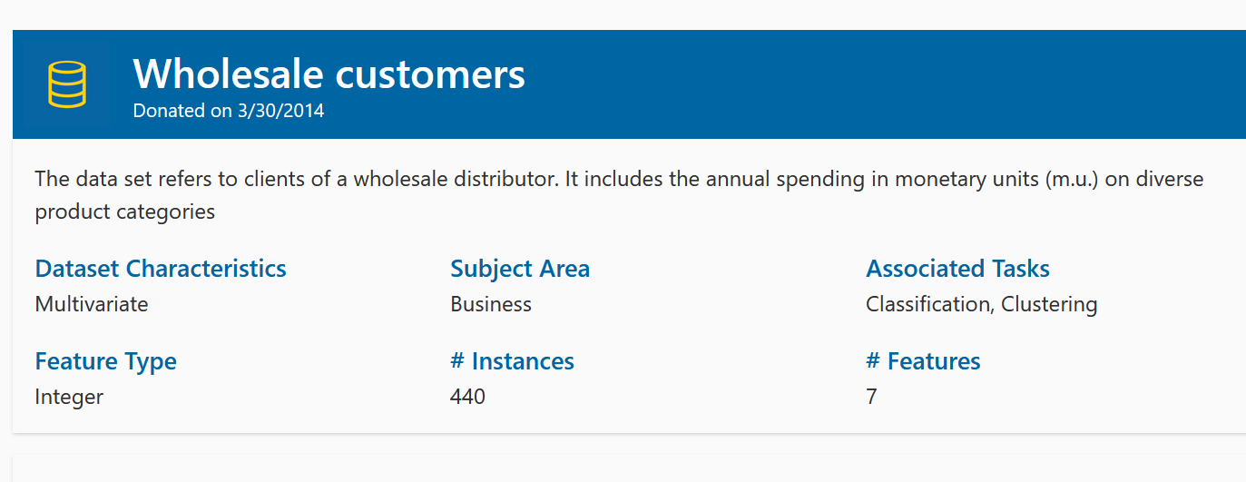
Wholesale customers
The data set refers to clients of a wholesale distributor.
It includes the annual spending in monetary units (m.u.) on diverse product categories
https://archive.ics.uci.edu/dataset/292/wholesale+customers

Slide 3
Tasks
Read the CSV file
Cluster SOM Neurons with K-Means
Perform Cluster Evaluation
Measure Silhouette Score and Davies–Bouldin Index for the formed 5 clusters
Display columns and type
StandardScaler features
Prepare and Train SOM

